Slide 1
Consumer Loan Securitization: A Data-Centric Review
OMFIT 2019-2
Mathew Simons
November 2023

Slide 2
Securitization and Structured Finance
Securitization is the process of taking an illiquid asset or group of assets and, through financial engineering, transforming it (or them) into an investable security.
Source: Investopedia
Securitization is the core of structured finance. It is the method by which those in structured finance create asset pools and ultimately form complex financial instruments that are useful to corporations and investors with special needs.
Source: corporatefinanceinstitute.com
Class A
Loan 1
Special
Purpose
Vehicle
(SPV)
Class B
Loan 2
Loan 3
Class C
. . .
Class D
Loan n
Class E

Slide 3
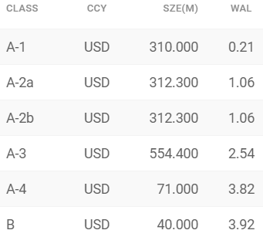
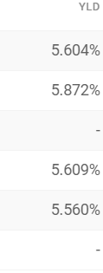
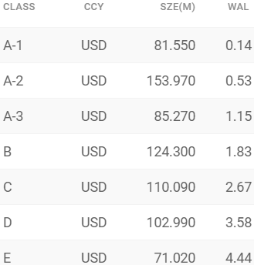
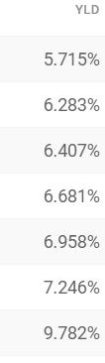
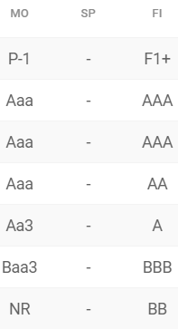
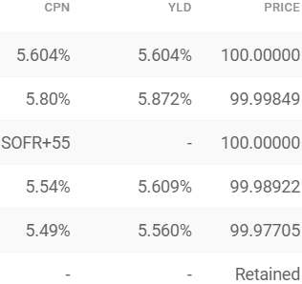
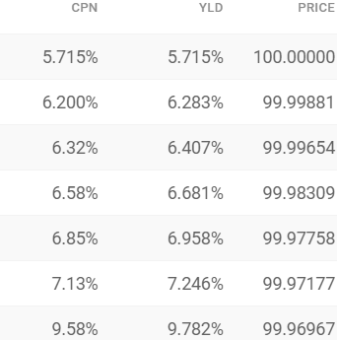
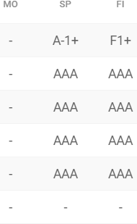
Risk vs Return
Toyota (prime auto loans)
Exeter (non-prime auto loans)
Source: Finsight

Slide 4
Real World Examples
Past 12 months
Auto loans/lease/floorplan
GM ~ $15.5 billion
Ford ~ $12 billion
Toyota ~ $10 billion
Capital One ~ $2 billion
RMBS
JPMorgan ~ $5.5 billion
Fannie Mae/Freddie Mac ~ $8 billion
Credit Card
American Express ~ $3.5 billion

Slide 5
Interest
Principal
Protection
from losses
Class A
40%
What if losses are … ?
Class B
30%
30%
5%
10%
100%
Class C
20%
10%
Class D
Losses

Slide 6
OneMain
Online lending platform
Focuses on non-prime borrowers that would not be able to get a loan from a traditional bank
Offers various products (auto loans, personal loans, credit cards)
Average APR on loans originated in 2022 -> 26%
OneMain has securitized ~ $3.5 billion in last one year
~ $3 billion in consumer

Slide 7
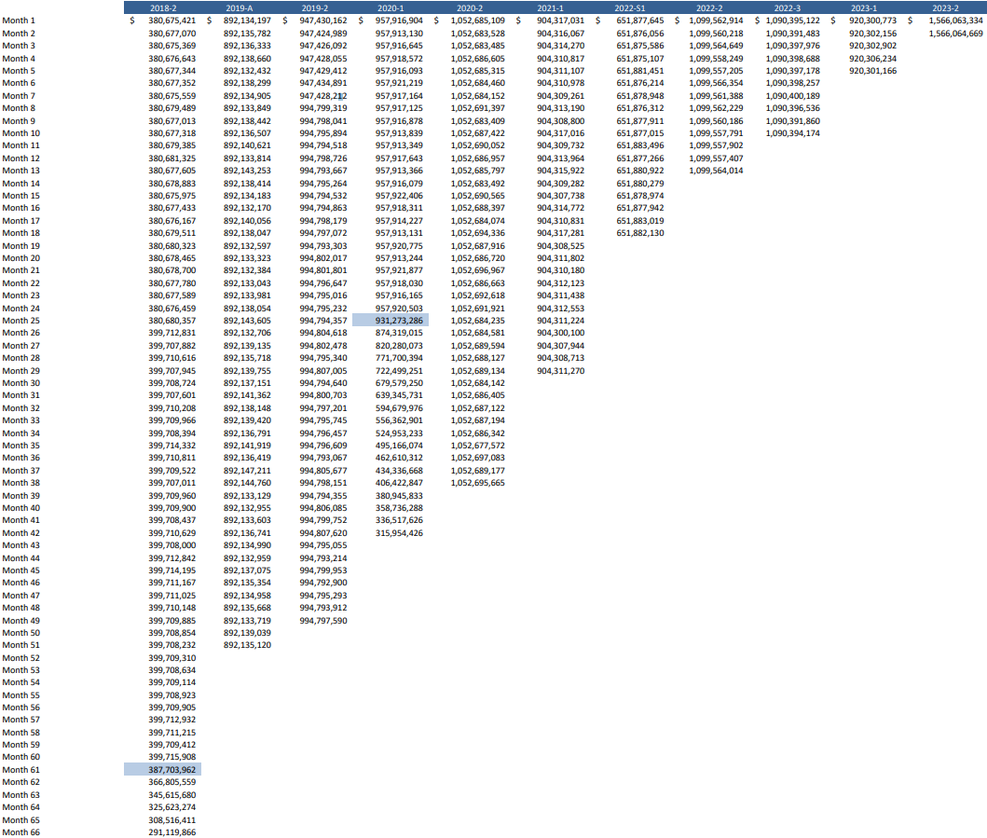
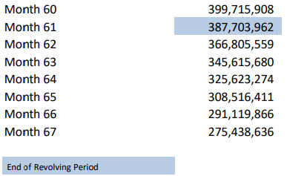
Balance History
Currently 11 outstanding consumer loan ABS
Source: OneMain

Slide 8
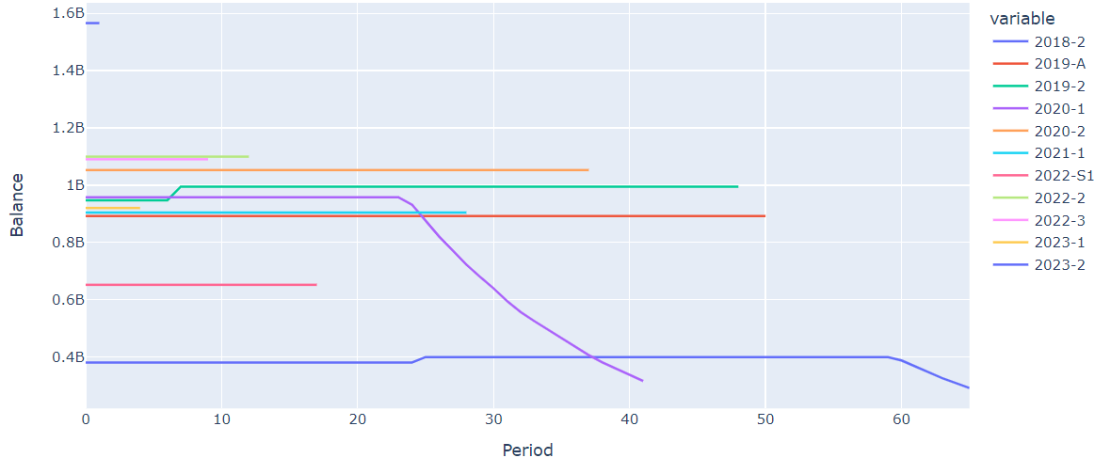
Balance History
Notes:
Ups and downs that are not uniform

Slide 9
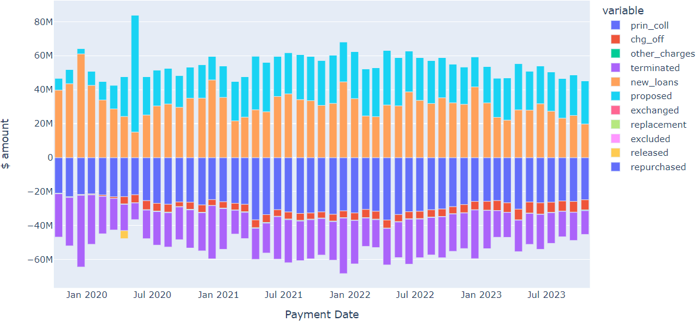
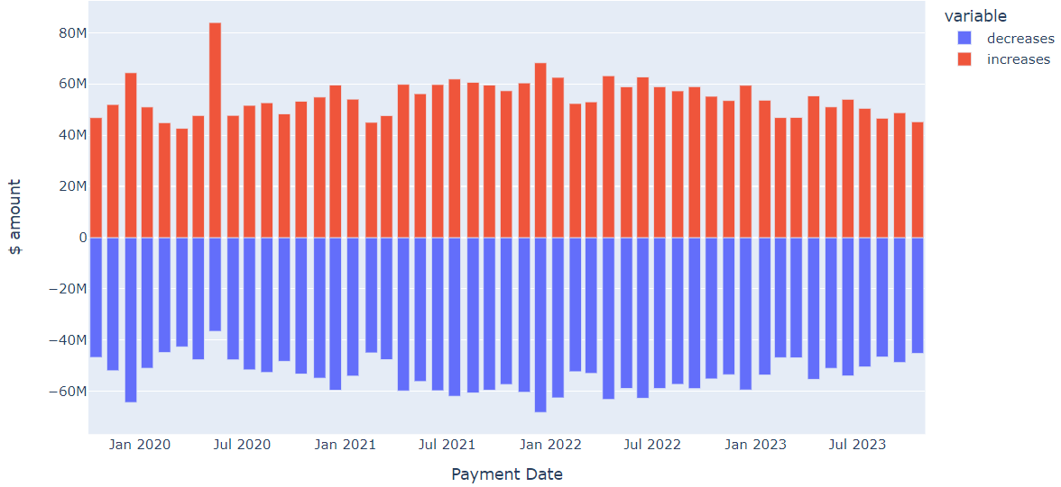
Components of Balance

Slide 10
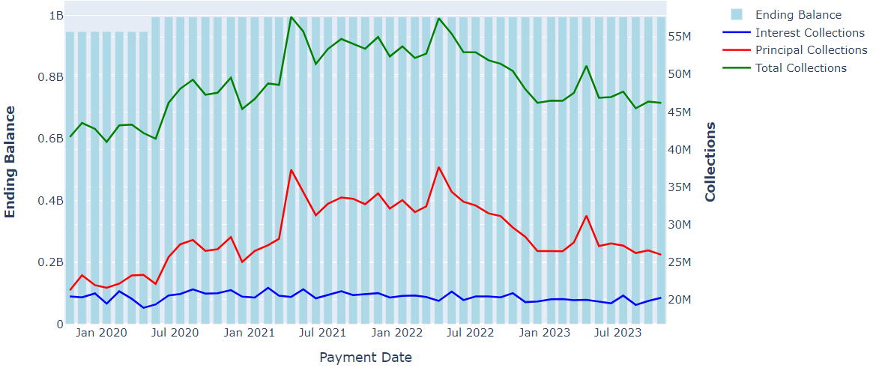
OMFIT 2019-2 Balance and Collections

Slide 11
Credit Enhancement and it’s many forms
Subordination
Percent of capital structure below each bond
Overcollateralization
Amount pool balance exceeds class balance
Can be calculated for each tranche and total deal
Reserve Account
A cash account used to cover shortfalls
Excess spread
Excess of pool collections over what is owed to expenses and classes

Slide 12
Credit Enhancement and it’s many forms

Slide 13
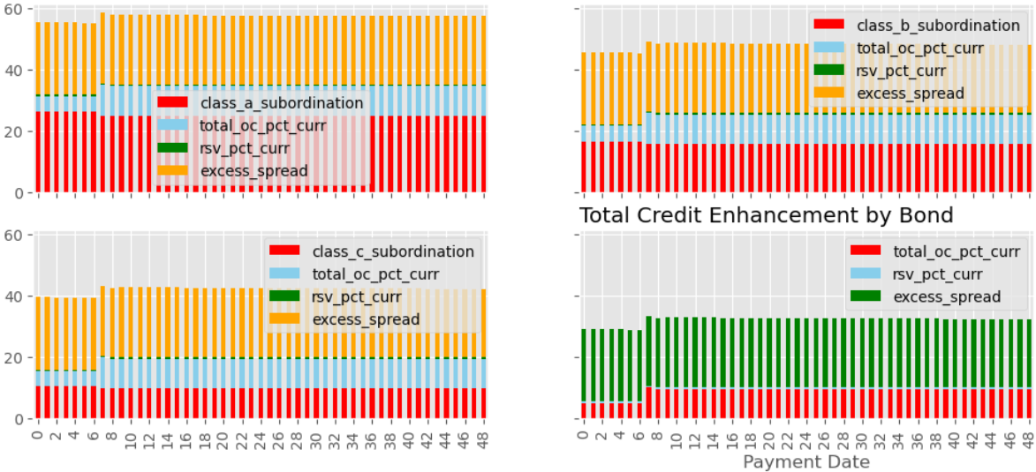
Credit Enhancement and it’s many forms

Slide 14
Losses

Slide 15
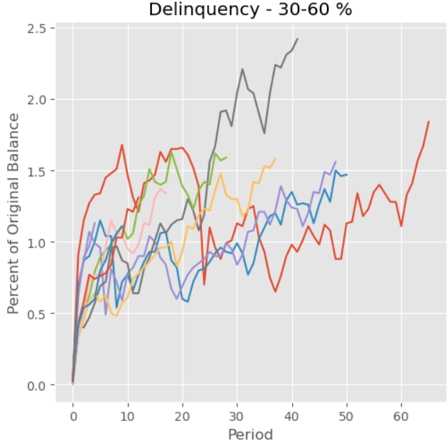
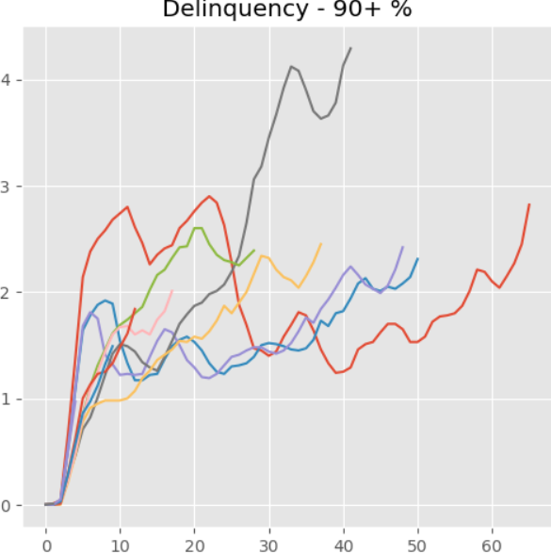
Delinquency
Source: OneMain monthly performance report
Notes:
Add y and x axis titles

Slide 16
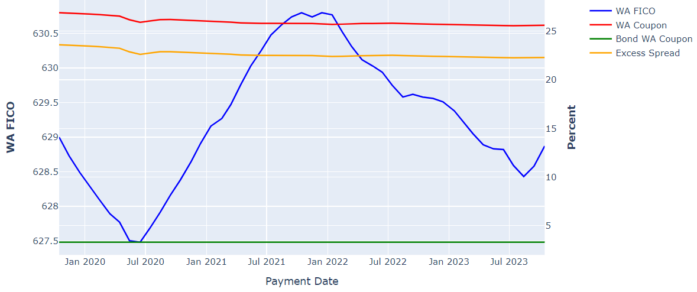
Weighted Average Coupon and FICO
Notes:
Fico not fixed across time
Possible reasons for shift

Slide 17
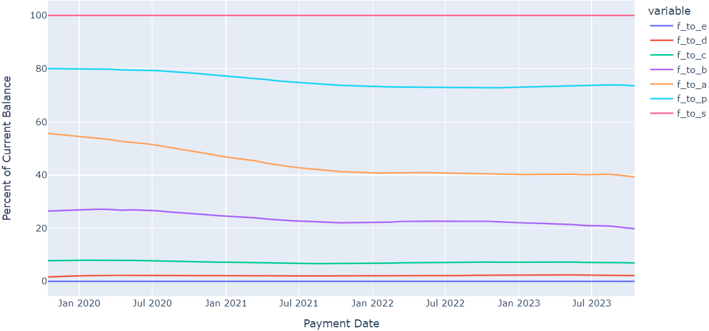
Reinvestment Criteria

Slide 18
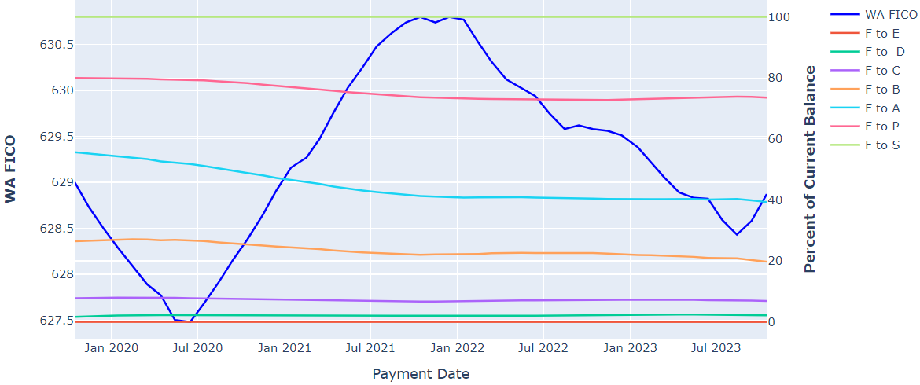
Shifting Characteristics

Slide 19
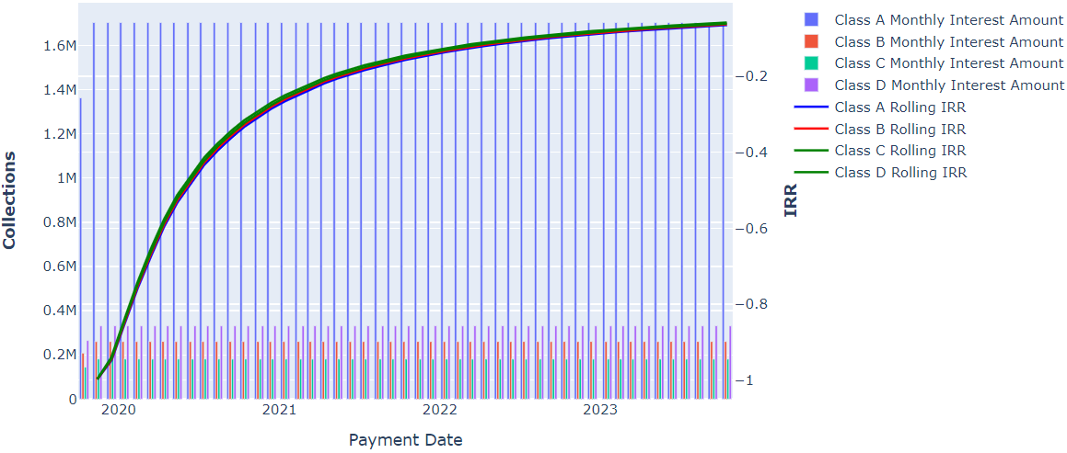
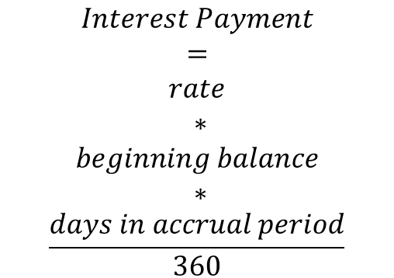
Returns to date
$$Interest Payment$$
$$=$$
$$rate$$
$$∗$$
$$beginning balance$$
$$∗$$
$$\frac{days in accrual period}{360}$$

Slide 20
Future Considerations
Make the code more dynamic
Next step would to be have it work for any OneMain deal
Because there isn’t reporting standardization across issuers and trustees, it would be very difficult to create a universal script. However, much of this data is available from data sources like Bloomberg. With access to already clean data, it would be much easier to compare across issuers and asset classes.
With loan level data, more insight can be gleaned into how certain loan characteristics correlate with performance (i.e. do lower FICOs really lead to higher defaults)
There are additional performance metrics that can be calculated with loan level data (i.e. roll rate, which is the percent of borrowers that move from one delinquency bucket to the next)

